Slide 1
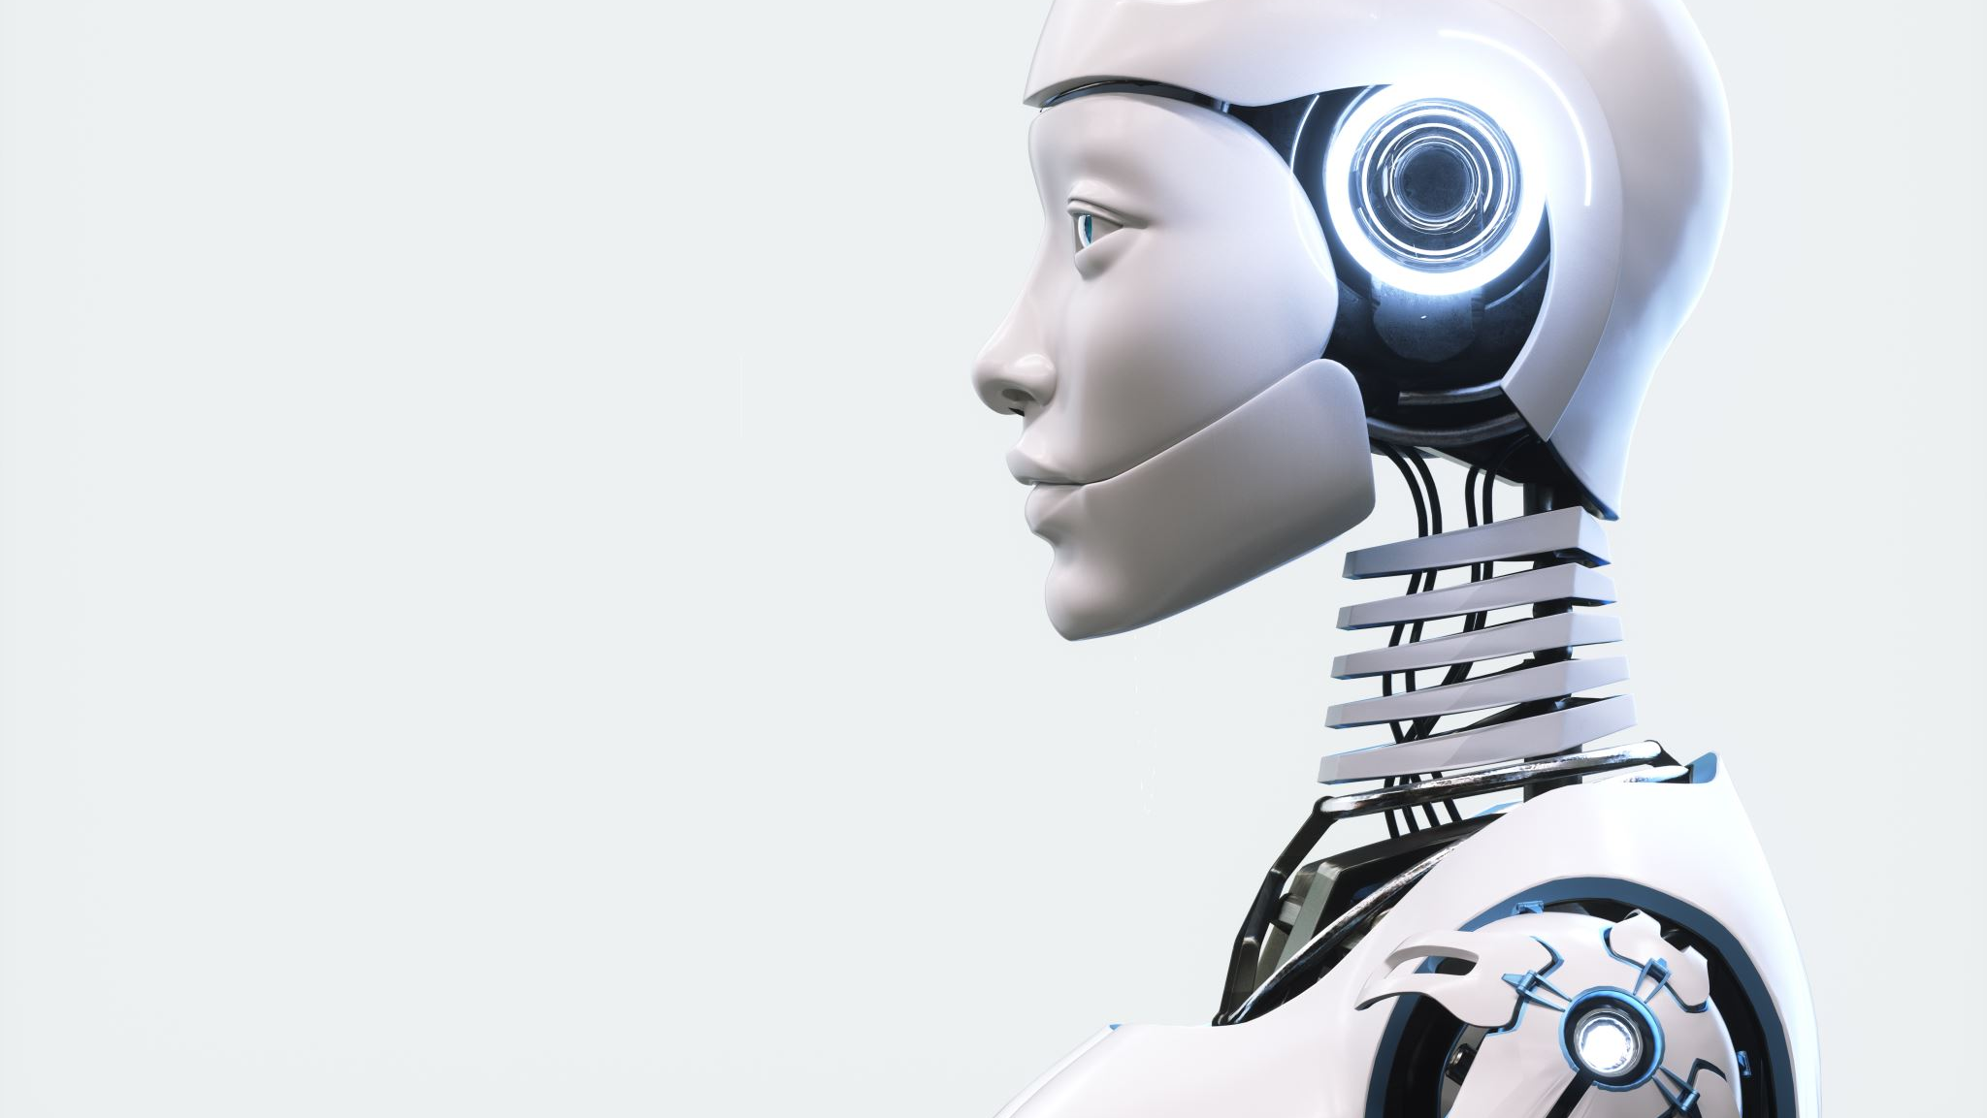
CHATBOT POWERED BY GEN AI
UMASS LOWELL
By – Kavya Sree Soma,
Aneesh Vempa

Slide 2
Traditional Searching followed by students
Google Search
Chat GPT
Knowledge Base Search

Slide 3
Knowledge base/ Google search Limitations
Information Overload
Lack of Context
Time-Consuming
Static Responses

Slide 4
ChatGPT Limitations
Generic Responses
No Source
Out of Date Information
Privacy and Security

Slide 5
Why AI Chat bot?
Interactive
Tailored Responses
Personalization
Efficiency
Compliance and Security

Slide 6
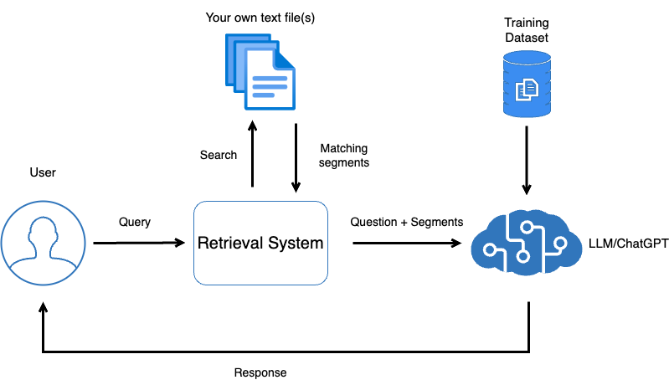
Basic Details

Slide 7
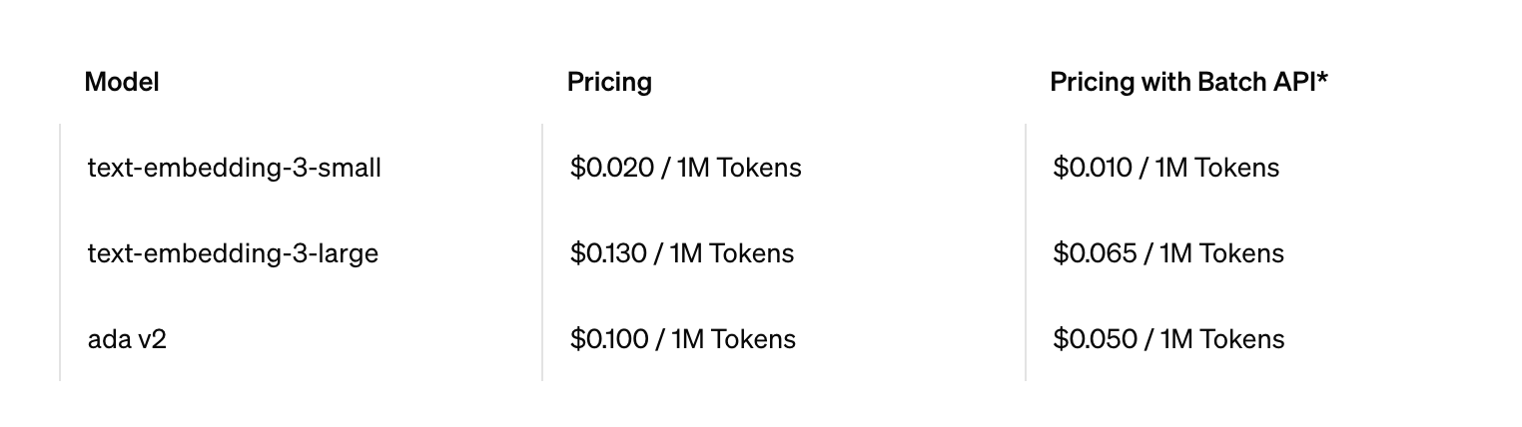
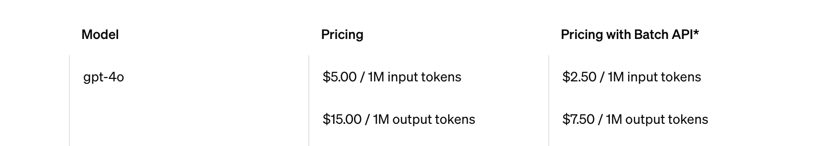
Open AI API Costing
Embedding Models
Language Models

Slide 8
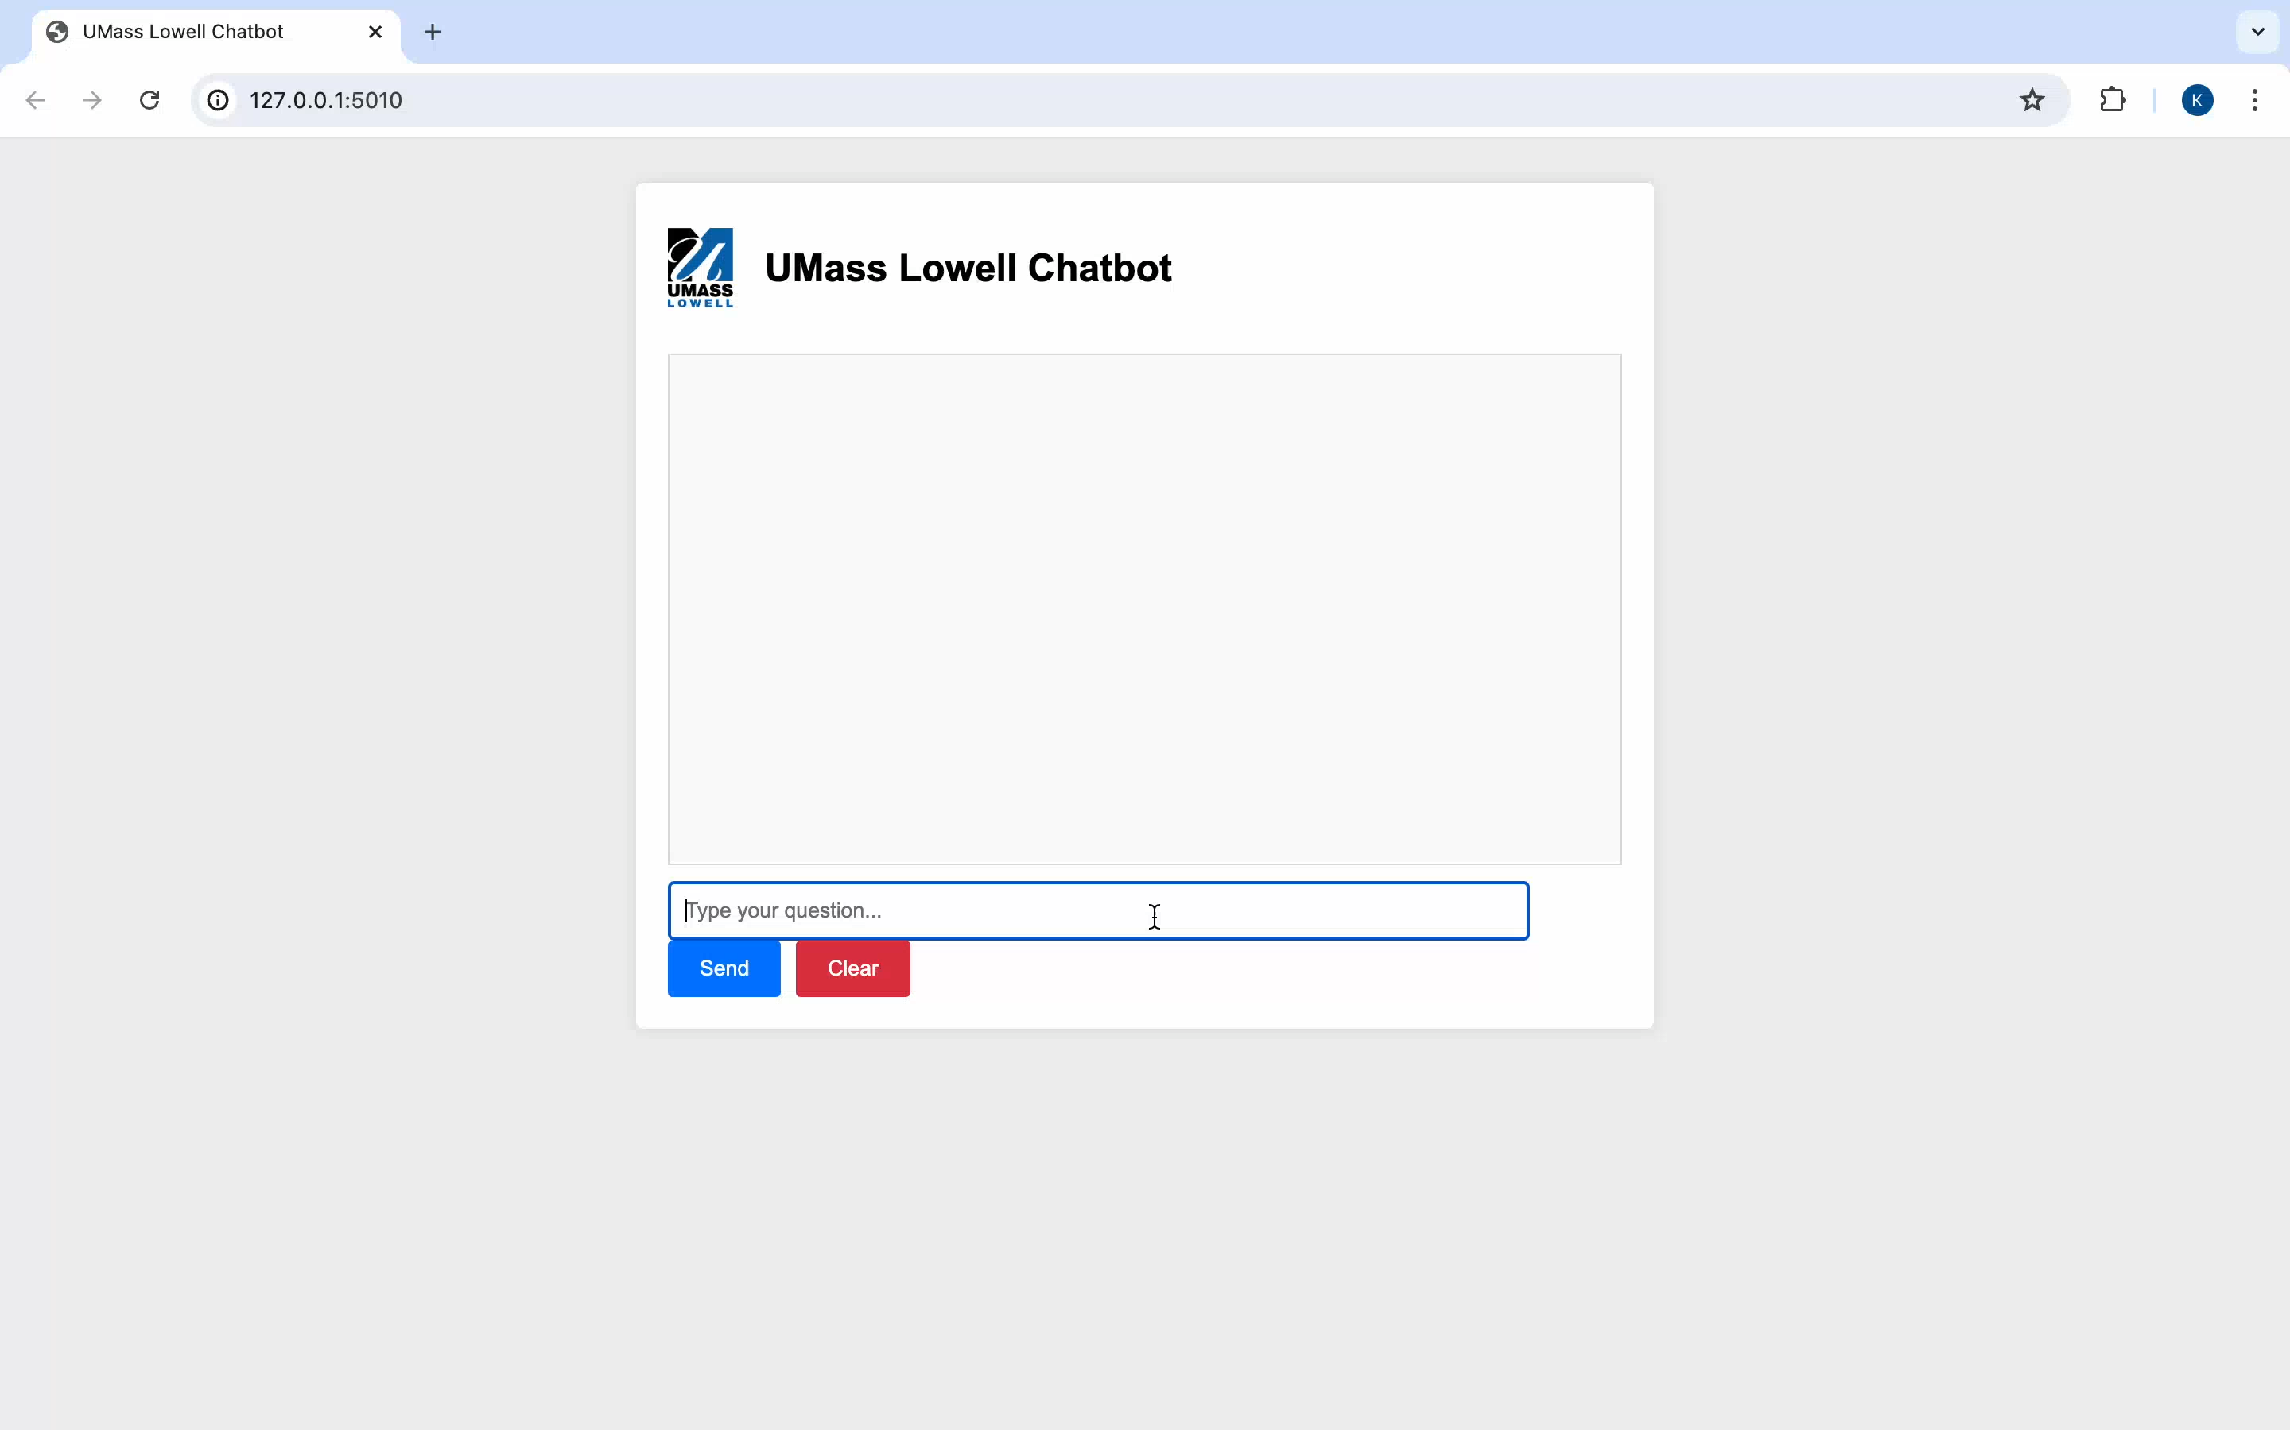
Demo

